Slide 1


e-Ration Web Service
2022 ISL Good Tech Scholar Program
Submitted by:
Pendyala venkata sai vardhija
Muhammed Nadeem mohammed basheer
Mentors from IBM: Ms. Mamatha J. V., Mr. Sreekanth P.S.

Slide 2
ABSTRACT
Two-thirds of people in India live in poverty: 68.8% of the Indian population lives on less than $2 a day. Over 30% even have less than $1.25 per day available - they are considered extremely poor. It is apparent that their earnings are not enough for their daily existence. This is one of the main reasons that the State Governments have come up with the idea of food supplies for the their needy citizens. These foods are distributed raw to the citizens from centres such as “Ration Shops” or “Fair Price Shops” physically. Thus there are instances of corruptions and inadequate supply of food.
This is where an online system for allocating foods comes into the picture. Here, we present you a simple prototype of a web application where the citizens can directly know their allocated ration items and either accept the needed items or send it back to the government to avoid food wastage.
The app is developed with Atom and VScode IDE using MERN Stack and is compatible on all major updated web browsers; ie,Google Chrome Version 102.0.5005.62.
2022 ISL Good Tech Scholar Program
E-Ration Web Services

Slide 3
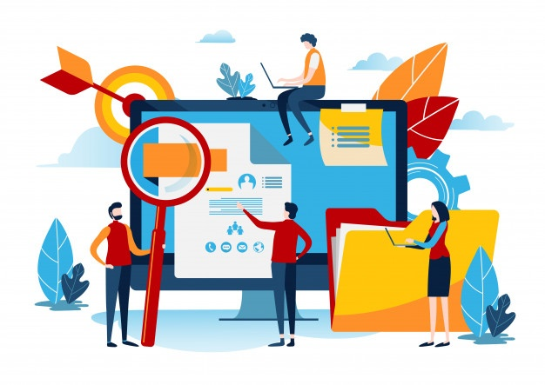
Development Environment
Software Requirements
IDE: Atom, VScode
Language: HTML, CSS, JSX, NodeJS (v14.17.1), ExpressJS, and ReactJS
System: 10th Generation Intel® Intel® Core™ i7-10510U Processor 1.8GHz quad-core NVIDIA® GeForce® MX350 8GB 2666MHz DDR4 RAM
512GB SATA 3 SSD
OS: Windows 11 Home
Development Platform:
Google Chrome
Server: Local Host (Node)
Database: Mongo DB - Atlas
OS: Windows 11 Home
DEVELOPER END
Hardware Requirements
USER END
Device: PC/ Smart Phone / Tablet
Processor: Intel Pentium 4 or later, or faster processor
RAM (Avg.): 20 Mb
Storage (Min.): 9 Mb
Connection: Internet Connection equired
2022 ISL Good Tech Scholar Program
E-Ration Web Services

Slide 4
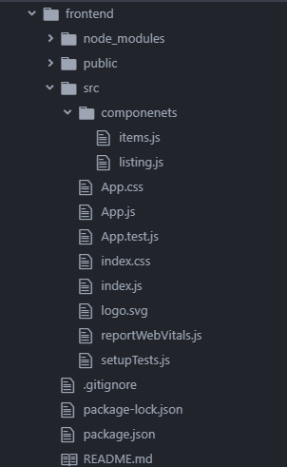
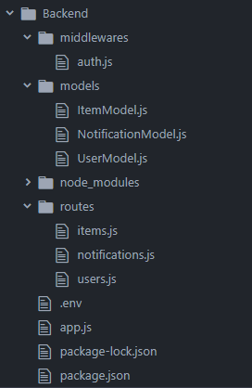
MODULES
Frontend
Backend
2022 ISL Good Tech Scholar Program
E-Ration Web Services

Slide 5
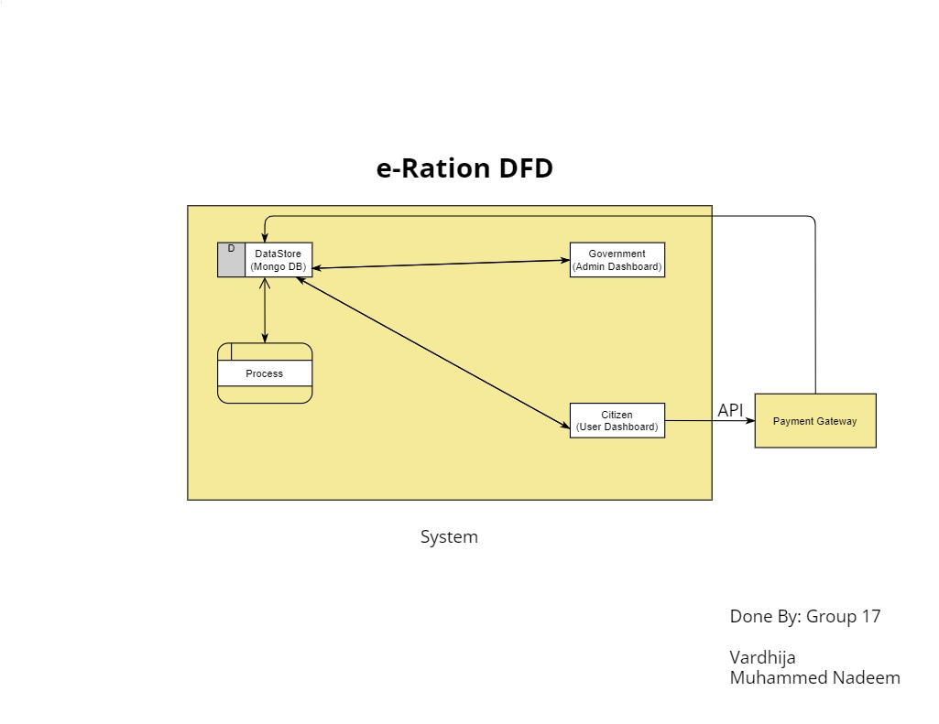
Data Flow
2022 ISL Good Tech Scholar Program
E-Ration Web Services

Slide 6
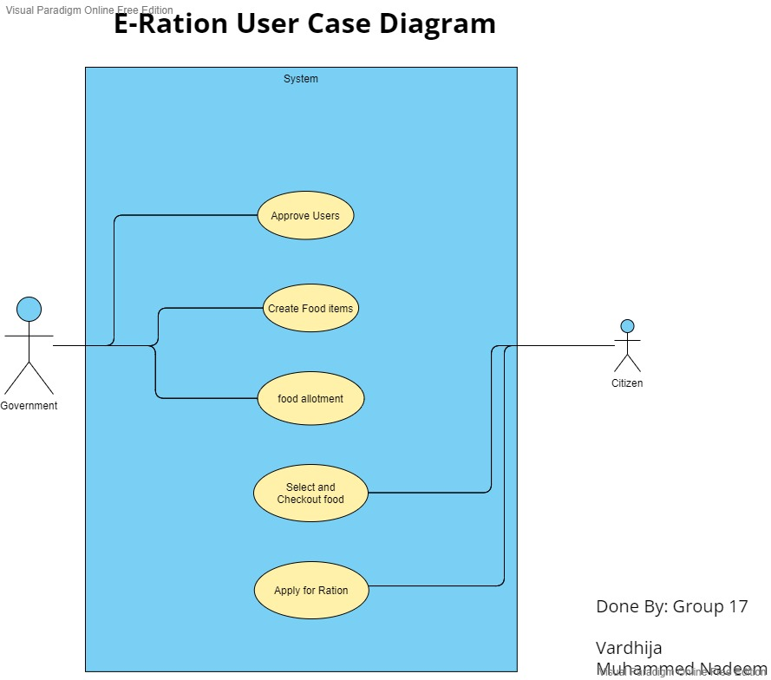
Use Case Diagram
2022 ISL Good Tech Scholar Program
E-Ration Web Services

Slide 7
Features
User authentication
User Authorization
Hashed and secured data
Helps to know the allotment of rations on time.
Cuts of intermediary costs.
Transactions can be more transparent as the its done directly.
Cloud storage is incorporated, so that the data is available anywhere at anytime in all devices.
2022 ISL Good Tech Scholar Program
E-Ration Web Services

Slide 8
ARCHITECTURE
2022 ISL Good Tech Scholar Program
E-Ration Web Services

Slide 9
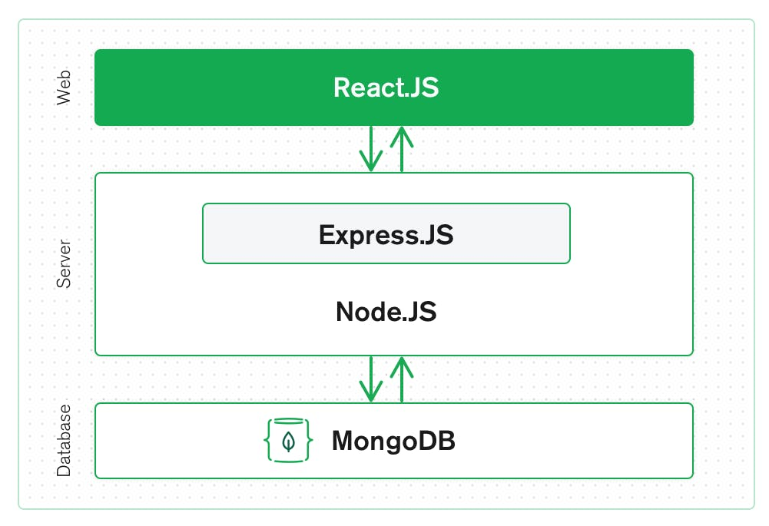
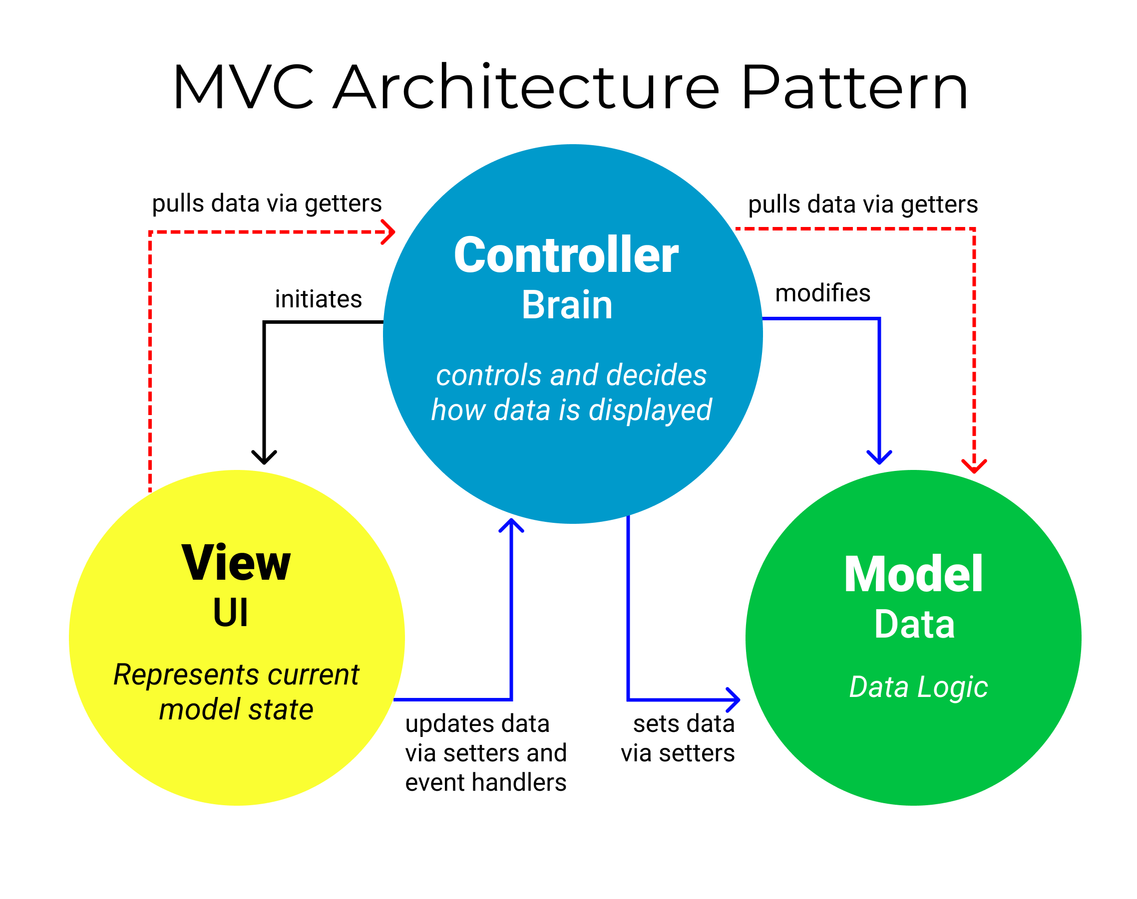
MERN ARCHITECTURE
We follow MERN architecture which is an implementation of the very efficient MVC architecture pattern.
E-Ration Web Services
2022 ISL Good Tech Scholar Program

Slide 10
SECURITY
2022 ISL Good Tech Scholar Program
E-Ration Web Services

Slide 11
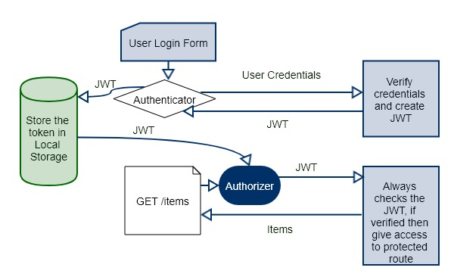
Authorization & Authentication
2022 ISL Good Tech Scholar Program
E-Ration Web Services

Slide 12
How it works…
Saves password in encrypted and hashed formats to the Database
An encrypted token is generated on user details and gets saved in the browser storage.
Authenticator authenticates user by decrypting the token
When logging in
To get access
When Registering
bcryptJS
JWT
2022 ISL Good Tech Scholar Program
E-Ration Web Services

Slide 13
USE CASES
2022 ISL Good Tech Scholar Program
E-Ration Web Services

Slide 14
1
2
3
4
5
6
Citizen Use
Cases
SIGN UP & LOGIN
Donate Others
CHECK FOR ALLOTMENTS
CHEKOUT
SELECT NEEDED GROCERIES
READ NOTIFICATIONS
2022 ISL Good Tech Scholar Program
E-Ration Web Services

Slide 15
1
2
3
4
5
6
Govt. Use
Cases
APPROVE SIGNUP
SEE DONATIONS
USER MANAGEMENT
VIEW ORDERS AND CHECKOUTS
CRUD NOTIFICATIONS
CRUD ITEMS AND ALLOTMENT
2022 ISL Good Tech Scholar Program
E-Ration Web Services

Slide 16
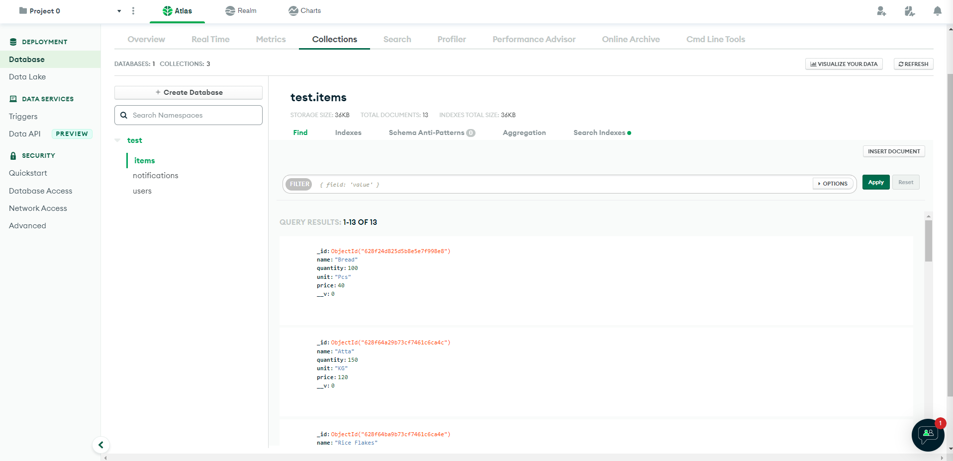
Data Stored in MongoDB-Atlas
2022 ISL Good Tech Scholar Program
E-Ration Web Services

Slide 17
References
Contributors
For concept and security:
Baral, P. (2020). Role-based User Access Control in MERN Stack applications.
For standards and syntax:
MDN - https://developer.mozilla.org/
W3Schools
NodeJS - https://nodejs.org/en/docs/
For Debugging Errors:
Stack overflow - https://stackoverflow.com/questions/72396135/data-is-not-being-saved-in-the-database-when-added-from-the-frontend-mern
For Database Related queries:
MongoDB - https://www.mongodb.com/docs/
Supporting And Mentoring:
Ms. Mamatha J. V.
Mr. Sreekanth P.S.
(Mentors from IBM)
Developers:
Ms. Pendyala Venkata Sai Vardhija
Mr. Muhammed Nadeem
Opportunity
2022 ISL Good Tech Scholar Program - IBM
2022 ISL Good Tech Scholar Program
E-Ration Web Services

Slide 18

Thank You!
2022 ISL Good Tech Scholar Program
E-Ration Web Services

